Slide 1

Prediction of insurance claims using health analysis

Slide 2
OBJECTIVE
To predict the amount how much an individual can claim to a health insurance policy by comparing his/her health report with the existing dataset.

Slide 3

ABSTRACT
Healthcare insurance in india is one of the fastest growing industries.However,this wide scope for growth indicates the limited penetration of health insurance among the Indian population.According to latest report by NSSO(National Sample Survey Organisation) only 20%of Indian population had health insurance coverage.Only 18 percent of population residing in urban areas and 14 percent population residing in rural areas had any form of health insurance coverage.Our aim is to make every people to know their cost for claiming the health insurance policy using the machine learning algorithm .

Slide 4
TYPES OF HEALTH INSURANCE
HOSPITALIZATION PLANS
If the family applies for a family health plan cover of Rs 3 lakhs, then any family member can claim medical benefit for more than Rs 1 lakh so long as it is within the overall sum assured of Rs 3 lakhs.
2.HOSPITAL DAILY CASH BENEFIT PLANS
Hospital daily cash benefit plans gives you a daily benefit for every 24 hours.
3.CRITICAL ILLNESS PLANS
By nature, critical illnesses are high severity and low frequency and cost of treatment is higher compared to regular medical problems like heart attack, stroke, among others.

Slide 5
EXISTING SYSTEMS
Due to tight schedule these days ,it has become quite impossible to visit different offices or branches of different health insurance companies in order to compare various medical insurance policies. So the insurance offices understands the dilemma of the customer and offered a platform where you can compare health insurance policies online.
Steps followed by several policy offices
*Know your clients
*Slice and dice the data
*Make it a process
*Use email marketting

Slide 6
PROPOSED SYSTEM
Insurance companies apply numerous models for analysing and predicting the health insurance cost . They use several statistical techniques . Machine learning approach is used for predicting high cost expenditures in health care . In machine learning , for handling large number of data ,we used to split the data into 3 sets(Training,development and test set)

Slide 7
ARCHITECTURE
IMPORTING THE LIBRARIES
READING THE CSV FILE
DATA DISTRIBUTION ANALYSIS
AVERAGE COST ANALYSIS
TRAINING THE MODULE
PREDICTION AND EVALUATION
PLOT THE FEATURE IMPORTANCE OF FOREST
PREDICTING THE NEW DATA

Slide 8

IMPORTING THE LIBRARIES
import pandas as pd
from matplotlib import pyplot as plt
from sklearn.ensemble import ExtraTreesRegressor
from sklearn.preprocessing import LabelEncoder, StandardScaler
from sklearn.model_selection import train_test_split
import numpy as np
import sklearn.metrics
Libraries allows us to perform many actions without writing the code.

Slide 9
READING THE DATA FROM CSV FILE
df = pd.read_csv('insurance.csv')
df = df.dropna()
The csv file which contains the dataset like age,sex,region,charges,children,smoker and bmi is imported into the code
Sometimes csv file has null values, which are later displayed as NaN in Data Frame. Pandas dropna() method allows the user to analyze and drop Rows/Columns with Null values in different ways.

Slide 10
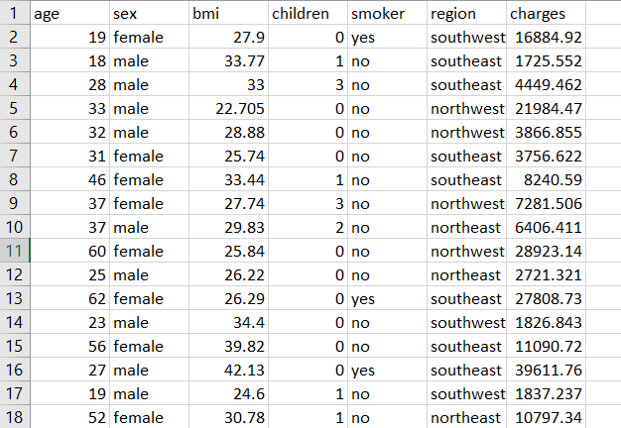
dataset

Slide 11
Data distribution analysis
variables = ['sex','smoker','region','age','bmi','children']
for v in variables:
df['bmi_int'] = df['bmi'].apply(lambda x: int(x))
df[v].value_counts().plot(kind = ‘bar’)
plt.title(v)
plt.show()
When dealing with a set of data, often the first thing you’ll want to do is get a sense for how the variables are distributed.To visualize how the data has been distributed , we have used the bar graph for all the columns .

Slide 12
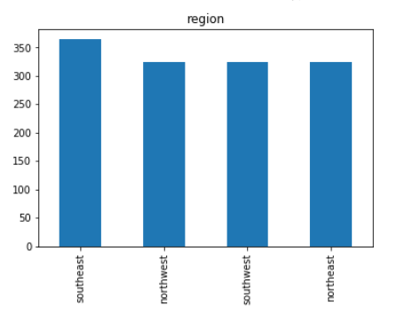
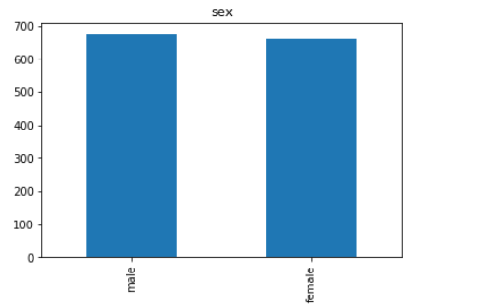
Data distribution analysis for the columns region and the sex

Slide 13
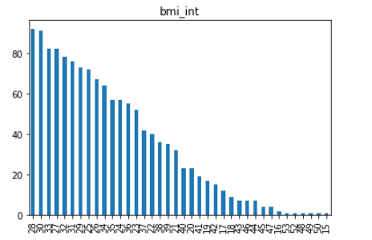
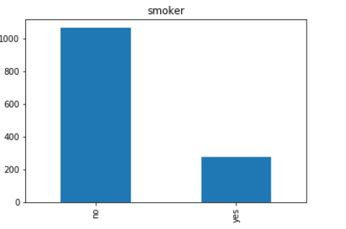
DATA DISTRIBUTION ANALYSIS FOR BMI AND SMOKER

Slide 14

AVERAGE COST ANALYSIS
for v in variables:
group_df=df.groupby(pd.Grouper(key=v)).mean()
group_df = group_df.sort_index()
group_df.plot(y = ['charges'],kind = ‘pie')
plt.show()
The Average Cost is the per unit cost of production obtained by dividing the total cost (TC) by the total output (Q).

Slide 15
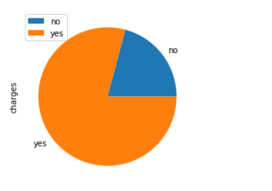
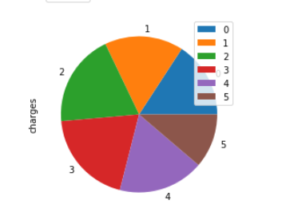
Average cost analysis for the columns smoker and children

Slide 16
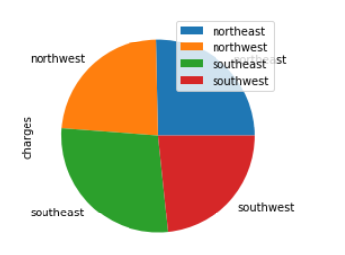
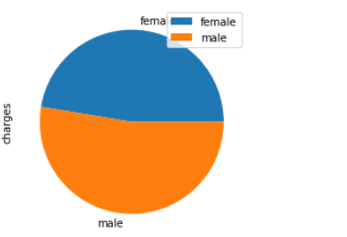
AVERAGE COST ANALYSIS FOR REGION AND GENDER

Slide 17
TRANSFORMING THE CATEGORICAL DATA
le_sex = LabelEncoder()
le_smoker = LabelEncoder()
le_region = LabelEncoder()
The LabelEncoder() is used to convert the categorical data ,text data into numbers (i.e. 0’s and 1’s). In the above program the objects sex,region,amd smoker are transformed into number for the prediction of new data.

Slide 18
Training , testing and splitting the datasets
X_train, X_test, y_train, y_test = train_test_split(X, Y, test_size=0.2)
The given data set is splitting into two different datasets
Independent variable(x_train,x_test)
Dependent variable (y_train,y_test)
Test size is 0.2 which is normally used in the data science. Thus the testing data is splitted as 20%
If we use test_size ,then there is no need of train_size ,as it automatically predicts that as 80%
Thus we are splitting the data in 80:20 ratio

Slide 19

EXTRA TREES REGRESSOR(Extremely random trees)
regressor = ExtraTreesRegressor(n_estimators = 100)
regressor.fit(X_train,y_train)
An extra-trees regressor.
This class implements a meta estimator that fits a number of randomized decision trees (a.k.a. extra-trees) on various sub-samples of the dataset and use averaging to improve the predictive accuracy and control over-fitting.

Slide 20
CALCULATING MAE AND RMSE AFTER TRAINING AND TESTING THE DATA
print("Train MAE: ", sklearn.metrics.mean_absolute_error(y_train, y_train_pred))
print("Train RMSE: ", np.sqrt(sklearn.metrics.mean_squared_error(y_train, y_train_pred)))
print("Test MAE: ", sklearn.metrics.mean_absolute_error(y_test, y_test_pred))
print("Test RMSE: ", np.sqrt(sklearn.metrics.mean_squared_error(y_test, y_test_pred)))
The Mean Absolute Error and the Root Mean Square Error are calculated between y_train ,y_train_predicted value and also between y_test and y_predicted value

Slide 21
Feature important of the forest
plt.figure()
plt.title("Feature importances")
plt.bar(importance_list, importances[indices],
color="r", yerr=std[indices], align="center")
plt.show()
To predict and visualize which feature has more importance in the dataset , a bar graph is plotted.

Slide 22
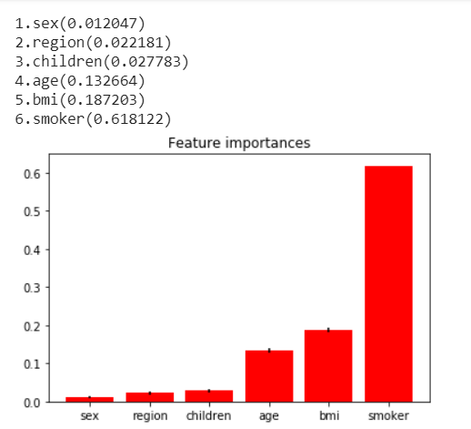
Feature importance value

Slide 23
Prrediction of new data
austro = ['male','yes','southeast',25,30.5,2]
print('austro - ',str(austro))
austro[0] = le_sex.transform([austro[0]])[0]
austro[1] = le_smoker.transform([austro[1]])[0]
austro[2] = le_region.transform([austro[2]])[0]
X = sc.transform([austro])
cost_for_austro = regressor.predict(X)[0]
print('Cost for austro = ',cost_for_austro,'\n\n')
The cost that can be claimed by an individual is predicted

Slide 24
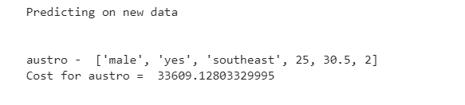
The output of the new predicted dATA

Slide 25
THANK YOU!
Done by
UVA PRASANTH.P
AUSTRO FLOVIN .V
JEFFRY DANIEL JEBAKUMAR.C

